Slide 1
HANDLING BIGGER DATA
Data nerding
What to do if your data’s too big

Slide 2
Your 5-7 things
Bigger data
Much bigger data
Much bigger data storage
Bigger data science teams

Slide 3

BIGGER DATA
Or, ‘data that’s a bit too big’
Notes:
Sooner or later, you’ll try to read in a file that’s too big for your computer, or takes forever to process. Here’s some things to do.

Slide 4
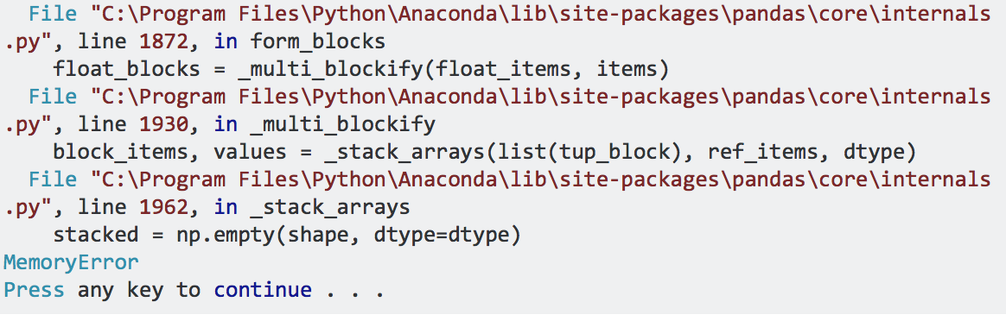
First, don’t panic
Notes:
If you have a 32-bit machine, this will happen to you a lot. This is because Python on 32-bit machines only uses 2Gb of RAM. http://stackoverflow.com/questions/17557074/memory-error-when-using-pandas-read-csv

Slide 5
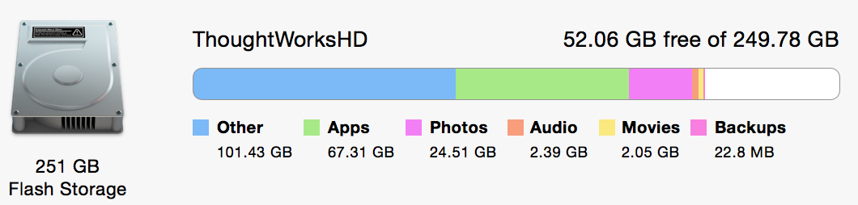
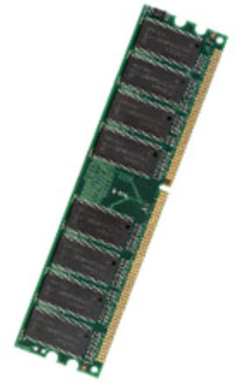
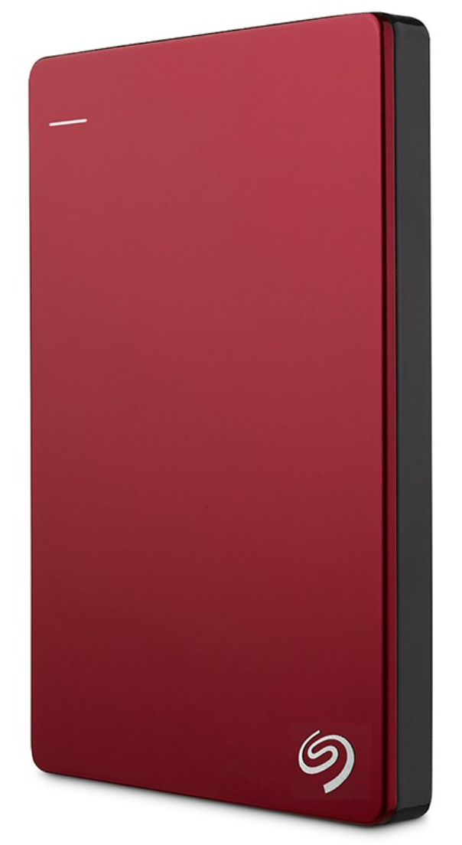
Computer storage
250Gb Internal hard drive. (hopefully) permanent storage. The place you’re storing photos, data etc
16Gb RAM. Temporary storage. The place read_csv loads your dataset into.
2Tb External hard drive. A handy place to keep bigger datafiles.
Notes:
There’s also read-only memory (ROM), where your PC stores internal data that it doesn’t want to lose.

Slide 6
Gigabytes, Terabytes etc.
Name | Size in bytes | Contains (roughly)
Byte | 1 | 1 character (‘a’, ‘1’ etc)
Kilobyte | 1,000 | Half a printed page
Megabyte | 1,000,000 | 1 novella. 5Mb = complete works of Shakespeare
Gigabyte | 1,000,000,000 | 1 high-fidelity symphony recording; 10m of shelved books
Terabyte | 1,000,000,000,000 | All the x-ray films in a large hospital; 10 = library of congress collection. 2.6 = Panama Papers leak
Petabyte | 1,000,000,000,000,000 | 2 = all US academic libraries; 10= 1 hour’s output from SKA telescope
Exabyte | 1,000,000,000,000,000,000 | 5 = all words ever spoken by humans
Zettabyte | 1,000,000,000,000,000,000,000
Yottabyte | 1,000,000,000,000,000,000,000,000 | Current storage capacity of the Internet
Notes:
“According to the CSIRO, in the next decade, astronomers expect to be processing 10 petabytes of data every hour from the Square Kilometre Array (SKA) telescope.[11] The array is thus expected to generate approximately one exabyte every four days of operation“ Quote and numbers from http://highscalability.com/blog/2012/9/11/how-big-is-a-petabyte-exabyte-zettabyte-or-a-yottabyte.html
Internet storage estimate: http://www.livescience.com/54094-how-big-is-the-internet.html

Slide 7
Things to Try: Too Big
Read data in ‘chunks’
csv_chunks = pandas.read_csv(‘myfile.csv’, chunksize = 10000)
Divide and conquer in your code:
csv_chunks = pandas.read_csv(‘myfile.csv’, skiprows=10000, chunksize = 10000)
Use parallel processing
E.g the Dask library

Slide 8
Things to try: Too Slow
Use %timeit to find where the speed problems are
Use compiled python, (e.g. the Numba library)
Use C code (via Cython)
Notes:
Numba: http://numba.pydata.org

Slide 9
MUCH BIGGER DATA
Or, ‘What if it really doesn’t fit?’

Slide 10
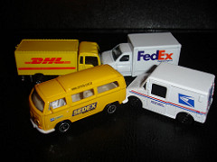




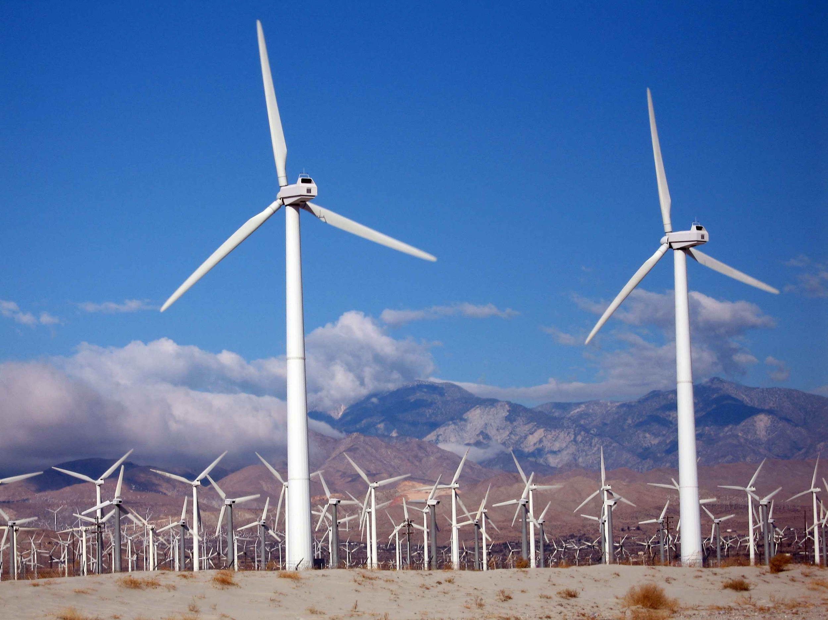
Volume, Velocity, Variety
Notes:
Most development data work is on small data: data that fits comfortably on your PC. Occasionally, you’ll be handling big data. Streaming big data sources include social media, sensor networks, transport data, search engine data, infrastructure data, payment data, internet sites.

Slide 11
Much Faster Datastreams
Twitter firehose:
Firehose averages 6,000 tweets per second
Record is 143,199 tweets in one second (Aug 3rd 2013, Japan)
Twitter public streams = 1% of Firehose steam
Google index (2013):
30 trillion unique pages on the internet
Google index = 100 petabytes (100 million gigabytes)
100 billion web searches a month
Search returned in about ⅛ second
Notes:
Twitter speeds: https://pushshift.io/tag/twitter/; tweets per second record: https://blog.twitter.com/2013/new-tweets-per-second-record-and-how (basically, Japan went crazy for a Miyazaki animation, which I thoroughly approve of!)
Google search sizes: http://venturebeat.com/2013/03/01/how-google-searches-30-trillion-web-pages-100-billion-times-a-month/

Slide 12
Distributed systems
Store the data on multiple ‘servers’:
Big idea: Distributed file systems
Replicate data (server hardware breaks more often than you think)
Do the processing on multiple servers:
Lots of code does the same thing to different pieces of data
Big idea: Map/Reduce
Notes:
So how do we deal with all this volume and velocity? This was Google’s problem in the 00s. They designed and built a distributed filesystem and processing method.

Slide 13
Parallel Processors
Laptop: 4 cores, 16 GB RAM, 256 GB disk
Workstation: 24 cores, 1 TB RAM
Clusters: as big as you can imagine…

Slide 14

Distributed filesystems
Notes:
This is HDFS in all its gory detail. (image from Wikipedia page on HDFS). The yellow boxes are servers (computers) grouped (usually physically) into racks.

Slide 15
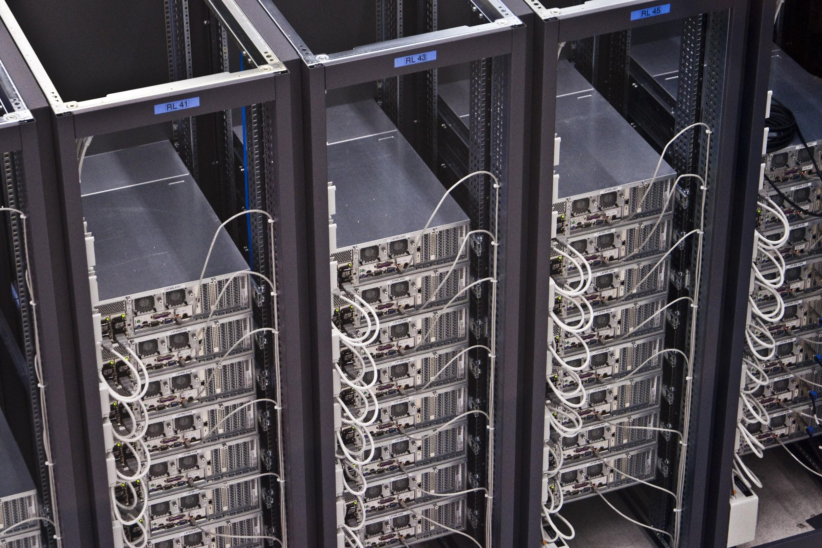
Your typical rack server...

Slide 16
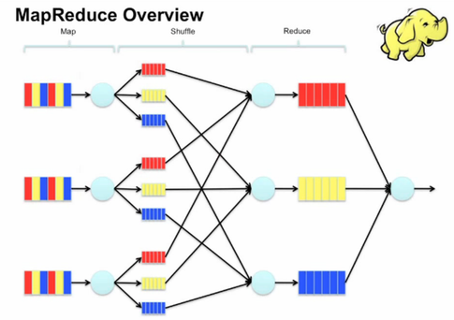
Map/Reduce: Crowdsourcing for computers
Notes:
https://www-01.ibm.com/software/data/infosphere/hadoop/mapreduce/
https://vimeo.com/13554436
https://www.quora.com/What-is-an-intuitive-explanation-of-MapReduce
Good example code for this: http://www.michael-noll.com/tutorials/writing-an-hadoop-mapreduce-program-in-python/

Slide 17
Distributed Programming Platforms
Hadoop
HDFS: distributed filesystem
MapReduce engine: processing
Spark
In-memory processing
Because moving data around is the biggest bottleneck
Notes:
Map/reduce gets the data and processes it. This means moving the data, which can take a lot of time. Spark solves this by doing the processing in the same place as the data: this is why it’s much faster than Hadoop Map/Reduce.
Panama Papers = 252 days to download on a fast server… http://www.livescience.com/54348-how-big-is-panama-papers-leak.html
Python and Spark? Use PySpark (see http://blog.cloudera.com/blog/2016/02/making-python-on-apache-hadoop-easier-with-anaconda-and-cdh/ for how to do this in notebooks)

Slide 18
Typical (Current) Ecosystem
Data warehouse
Publisher
Python
Spark
SQL
R
Tableau
HDFS

Slide 19
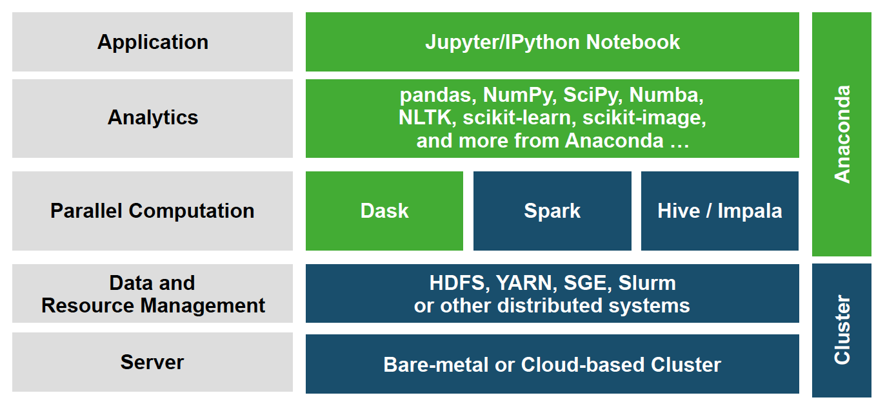
Anaconda comes with this…

Slide 20
Parallel Python Libraries
Dask
Datasets look like NumpyArrays, Pandas DataFrames
df.groupby(df.index).value.mean()
Direct access into HDFS, S3 etc
PySpark
Also has DataFrames
Connects to Spark
Notes:
Pyspark: http://www.slideshare.net/hkarau/a-really-really-fast-introduction-to-py-spark-lightning-fast-cluster-computing-with-python-1

Slide 21
MUCH BIGGER DATA STORAGE
Or, ‘Where do we put all this stuff?’

Slide 22
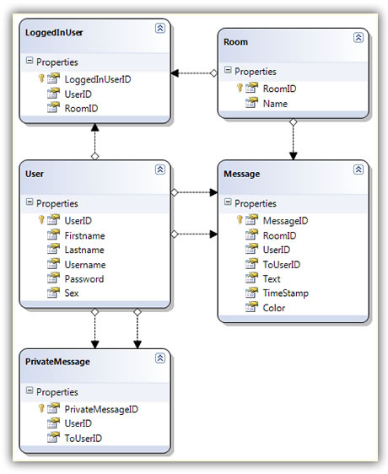
SQL Databases
Row/column tables
Keys
SQL query language
Joins etc (like Pandas)
Notes:
This is the basis of a sql database: row/column tables, connected by ‘keys’ that identify specific table rows (e.g. user id).
Python library: sqlite3 (stores database as a single file).

Slide 23
ETL (Extract - Transform - Load)
Extract
Extract data from multiple sources
Transform
Convert data into database formats (e.g. sql)
Load
Load data into database
Notes:
Example system: Pentaho’s Kettle.

Slide 24
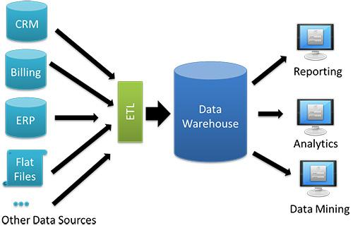
Data warehouses

Slide 25
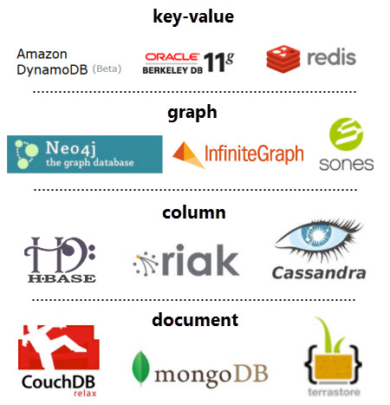
NoSql Databases
Not forced into row/column
Lots of different types
Key/value: can add feature without rewriting tables
Graph: stores nodes and edges
Column: useful if you have a lot more reads than writes
Document: general-purpose. MongoDb is commonly used.
Notes:
More: http://www.tomsitpro.com/articles/rdbms-sql-cassandra-dba-developer,2-547-2.html

Slide 26
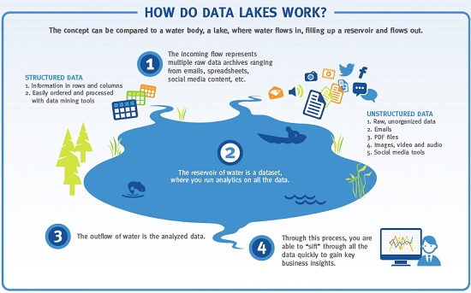
Data Lakes
Notes:
Big thing about data lakes is that you don’t do the transformation when you put data into them… you do this when you take data out.

Slide 27
BIGGER DATA SCIENCE TEAMS
Or, ‘Who does this stuff?’

Slide 28
Big Data Work
Data Science
Data Analysis
Data Engineering
Data Strategy

Slide 29
Big Data Science Teams
Usually seen:
Project manager
Business analysts
Data Scientists / Analysts: insight from data
Data Engineers / Developers: data flow implementation, production systems
Sometimes seen:
Data Architect: data flow design
User Experience / User Interface developer / Visual designer

Slide 30
Data Strategy
Why should data be important here?
Which business questions does this place have?
What data does/could this place have access to?
How much data work is already here?
Who has the data science gene?
What needs to change to make this place data-driven?
People (training, culture)
Processes
Technologies (data access, storage, analysis tools)
Data

Slide 31
Data Analysis
What are the statistics of this dataset?
E.g. which pages are popular
Usually on already-formatted data, e.g. google analytics results
Notes:
The differences between data analysis and data science have been written about a lot.

Slide 32
Data Science
Ask an interesting question
Get the data
Explore the data
Model the data
Communicate and visualize your results
Notes:
We know this one. We’ve been doing it. Except when the data gets big or fast, you start to need to include a data engineer…

Slide 33
Data Engineering
Big data storage
SQL, NoSQL
warehouses, lakes
Cloud computing architectures
Privacy / security
Uptime
Maintenance
Big data analytics
Distributed programming platforms
Privacy / security
Uptime
Maintenance
etc.
Notes:
Data engineers keep the lights on.

Slide 34
EXERCISES
Or, ‘Trying some of this out’

Slide 35
Exercises
Use pandas read_csv() to read a datafile in in chunks
Notes:
And read http://www.slideshare.net/continuumio/high-performance-hadoop-with-python-webinar

Slide 36
LEARNING MORE
Or, ‘books’

Slide 37
READING
“Books are a uniquely portable magic” – Stephen King

Slide 38
THANK YOU
sjterp@thoughtworks.com

